Slide 1



INFOSYS VIRTUAL INTERNSHIP
ELECTVIZ
ELECTION DATA VISUALIZATION FOR MEDIA
Group -1
Batch -11
Mentor - Mrs. Nityashree S J
Submitted by – Male Nikhitha

Slide 2

INTRODUCTION
ElectViz – Election Data Visualization for Media is an interactive data analytics project developed using Microsoft Power BI, aimed at analyzing Indian National-level General Election data from kaggle.
The project focuses on transforming large and complex election datasets into visually engaging and interactive dashboards.
These dashboards help users explore voting patterns, voter turnout, party performance, candidate participation, and gender representation across different states, regions, and election years.

Slide 3
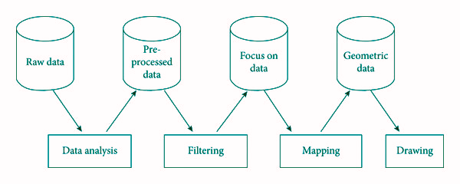
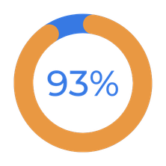
SYSTEM DESIGN & WORKFLOW
The ElectViz system is designed using a layered architecture where raw election data is first cleaned and transformed before analysis.
A structured data model enables efficient calculations, filtering, and cross-dashboard interactions in Power BI.
The final layer presents insights through interactive dashboards optimized for clarity, performance, and storytelling.

Slide 4

MILESTONES
Milestone 1: Data Collection & Preprocessing
Collected Indian General Election dataset from Kaggle
Cleaned and standardized data using Power Query
Milestone 2: Initial Dashboard Development
Designed Election Overview dashboard
Developed Gender Analysis and Regional Analysis pages
Implemented slicers and interactive visuals
Milestone 3: Core Trend & Participation Analysis
Built State-Wise Voting Trend dashboard
Developed Candidate Participation Analysis
Milestone 4: Advanced Insights & Performance Evaluation
Created Voter Turnout Analysis dashboard
Designed Top Party Performance dashboard
______________________________________________________________
______________________________________________________________

Slide 5
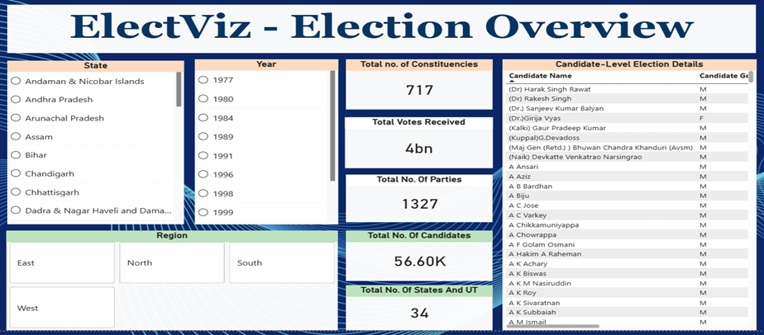
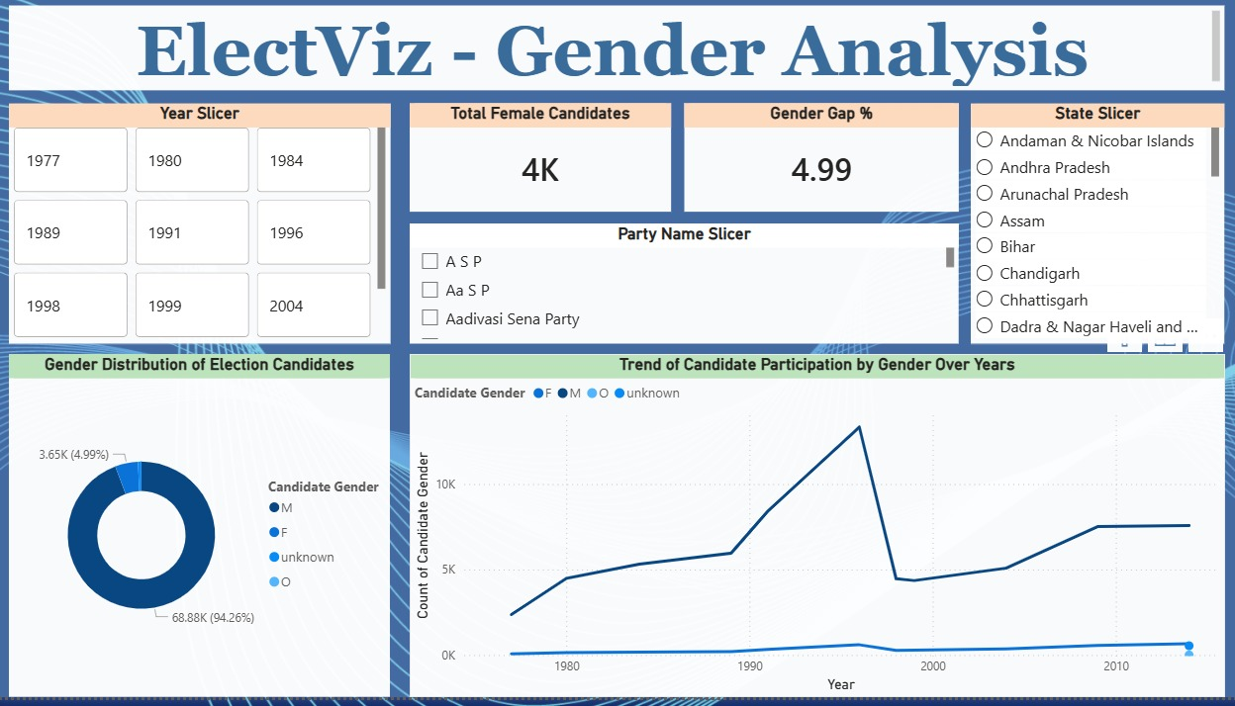
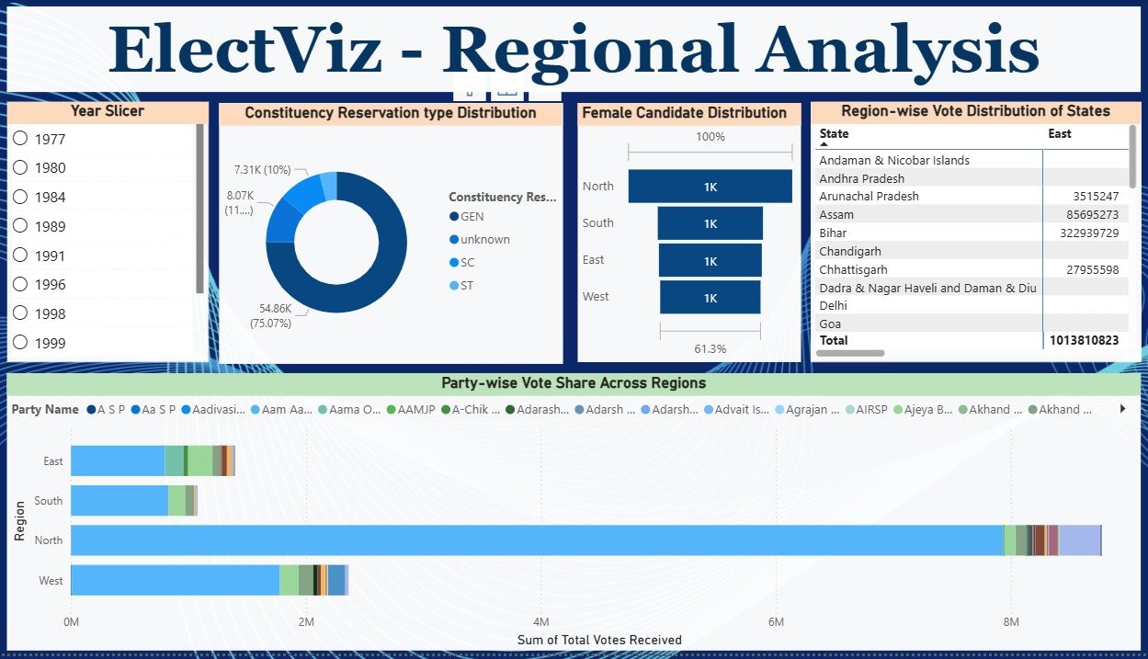
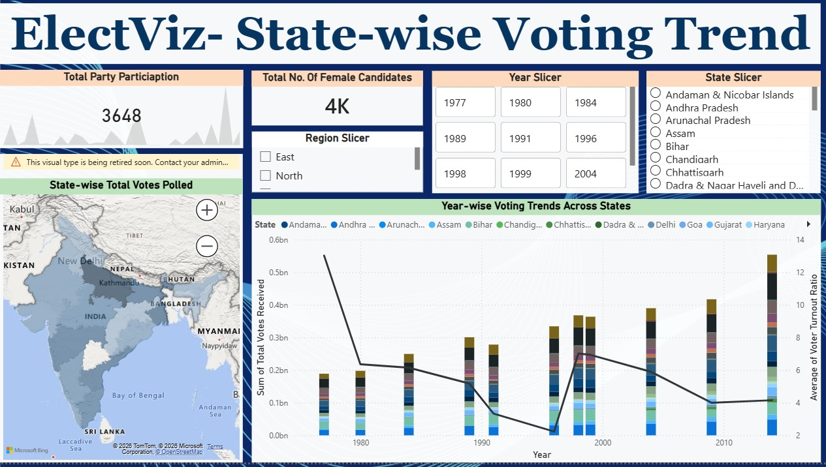
OUTCOMES

Slide 6
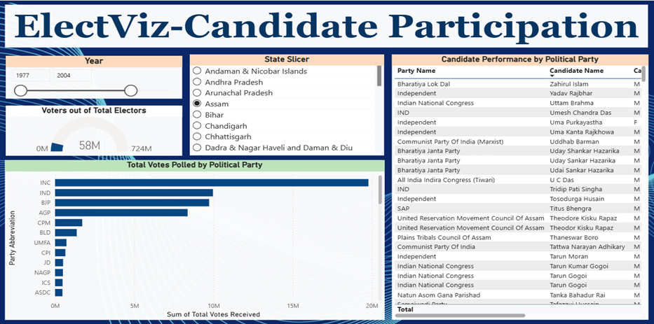
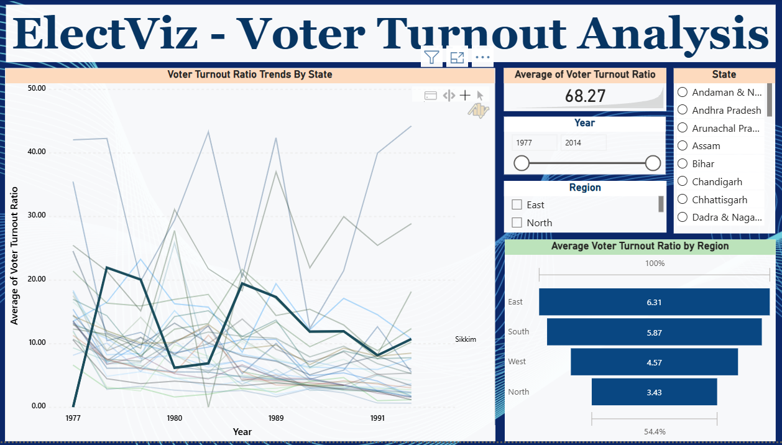
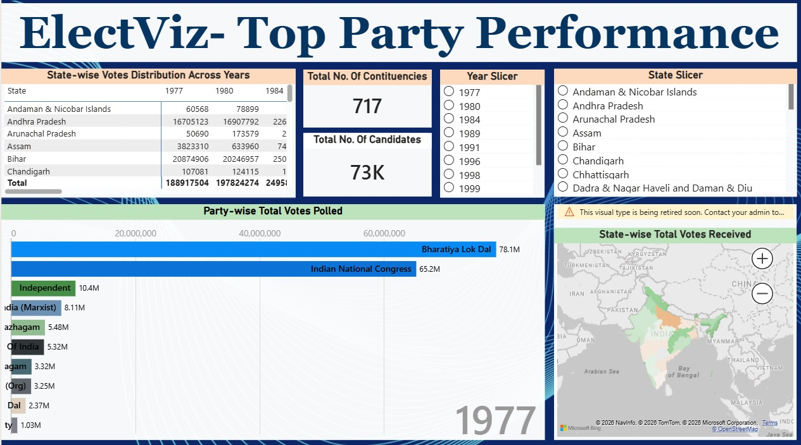

Slide 7


FUTURE ENHANCEMENTS
Real-Time Election Data Integration – Incorporate live election data feeds to provide real-time updates and dynamic dashboards.
Predictive Analysis – Apply machine learning techniques to forecast voter turnout and party performance trends.
Constituency-Level Deep Analysis – Expand the dashboard to include more granular constituency-wise insights and comparisons.
Advanced Comparative Analytics – Enable multi-year and multi-state comparative visualizations for deeper trend analysis.

Slide 8

The ElectViz project effectively transforms complex Indian election data into clear and interactive visual insights using Power BI.
It enables meaningful analysis of voting patterns, voter turnout, party performance, and candidate participation.
The dashboards support data-driven storytelling for media, analysts, and the general public.
Overall, the project demonstrates the real-world impact of data analytics and visualization in understanding democratic processes.
Conclusion

Slide 9
ACKNOWLEDGEMENT
REFERENCES
We would like to express our sincere gratitude to:
Infosys Springboard Team for organizing this valuable virtual internship opportunity
Our Mentor for continuous guidance, constructive feedback, and support
My Teammates for their collaboration, encouragement, and shared insights
This internship has been a meaningful step in enhancing our professional growth and technical expertise.
Election Dataset – Kaggle
Microsoft Power BI Official Documentation
Infosys Springboard Virtual Internship Course Materials
______________________________________________________________

Slide 10
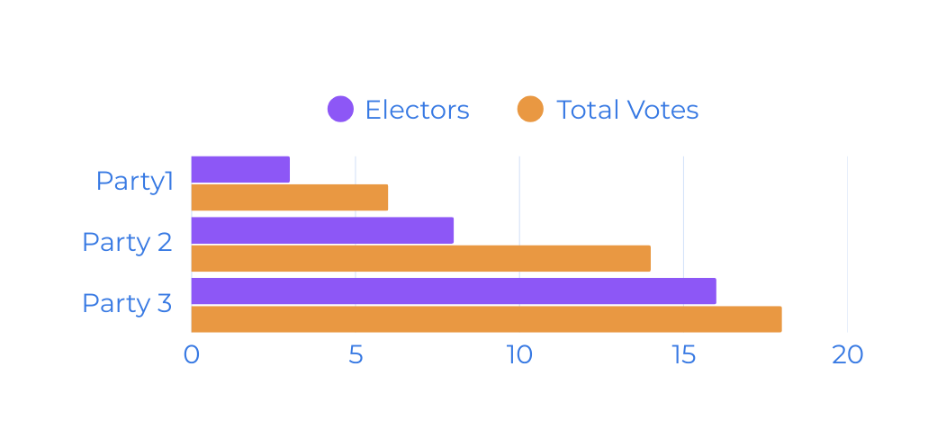
THANK YOU
For Your Attention

